Slide 1
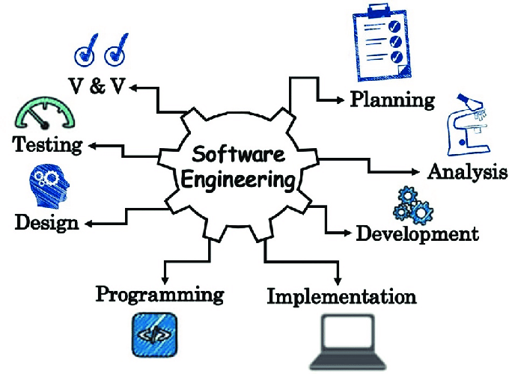


Slide 2
Unit- I Introduction: Evolution, Software development projects, Exploratory style of software developments, Emergence of software engineering, Notable changes in software development practices, Computer system engineering.
Software Life Cycle Models: Basic concepts, Waterfall model and its extensions, Rapid application development, Agile development model, Spiral model.

Slide 3
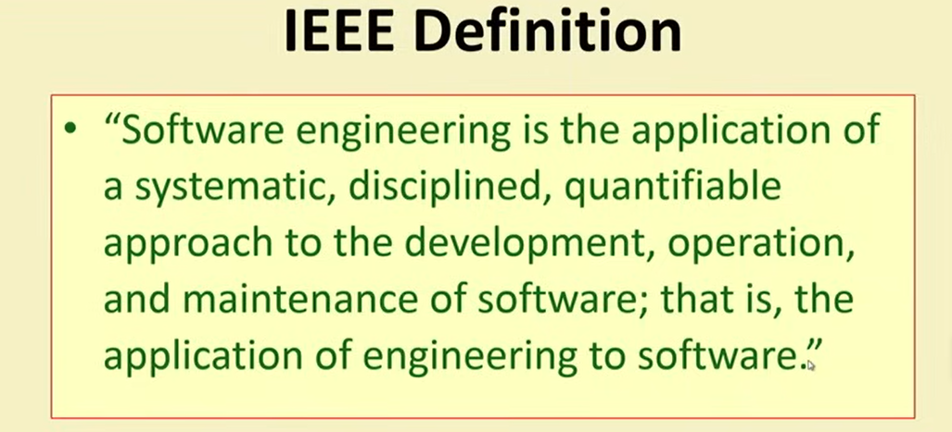

Slide 4
Software view
Data
Procedures
Software
Programs
Rules
Documentation
Figure 1.1: Software view

Slide 5
Characteristics of software
Efficiency: It provides a measure of the resource requirement of a software product efficiently.
Reliability: It assures that the product will deliver the same results when used in similar working environment.
Reusability: This attribute makes sure that the module can be used in multiple applications.
Maintainability: It is the ability of the software to be modified, repaired, or enhanced easily with changing requirements.
Portability: Run on any type of device (mobile, laptop, tablet)

Slide 6
Software characteristics
Software has logical properties rather than physical.
Software is mobile to change.
Software is produced in an engineering manner rather than in classical sense.
Software becomes obsolete but does not wear out or die.
Software has a certain operating environment, end user, and customer.
Software development is a labor-intensive task.

Slide 7
Software Classifications
Software
Generic
software
Customized
software
System software
Application software
Programming software
AI
software
Engineering/ scientific software
Web software
Product-line software
Figure 1.2: Software classification

Slide 8
Software Evolution
Software Evolution is a term that refers to the process of developing software initially, and then timely updating it for various reasons, i.e., to add new features or to remove obsolete functionalities
The software evolution process includes fundamental activities of change analysis, release planning, system implementation, and releasing a system to customers.

Slide 9
Software Evolution
Necessity of Software Evolution
1. Change in requirement with time
2. Environment change
3. Errors and bugs
4. Security risks
5. For having new functionality and features

Slide 11
Software development projects
The nine steps to follow for developing a software project
Evaluate your project. Assess the feasibility of your project.
Specify the requirements. Figure out and document the technical needs of the project.
Make a plan. Determine the specific components of the project and make a timeline for the completion of each task.
Conceptualize the design. Design the project's architecture and functions.
Establish metrics. Set up software metrics to help you continuously track and evaluate

Slide 12
Software development projects
The nine steps to follow for developing a software project
6. Develop the software. Develop and code the project.
7.Conduct testing. Rigorously test and conduct quality control assessments of the software.
8. Deploy the software. Deploy the software to production.
9. Perform post-production tasks. Conduct updates or maintenance work as needed on the software.

Slide 13
Exploratory Style of Software Development
Exploratory program development style refers to an informal development style or builds and fix the style in which the programmer uses his own intuition to develop a program rather than making use of the systematic body of knowledge which is categorized under the software engineering discipline.
This style does not offer any rules to start developing any software.

Slide 14
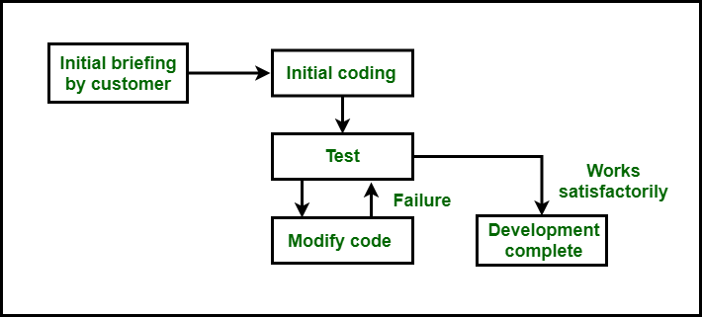
Exploratory style of software development

Slide 15
What’s wrong with this model?
Fig: Increase in development time and effort with problem size.

Slide 16
Emergence of software engineering
software engineering techniques have evolved over many years in the past. This evolution is the result of a series of innovations and accumulation of experience about writing good quality programs.
Since these innovations and programming experiences are too numerous, let us briefly examine only a few of these innovations

Slide 17
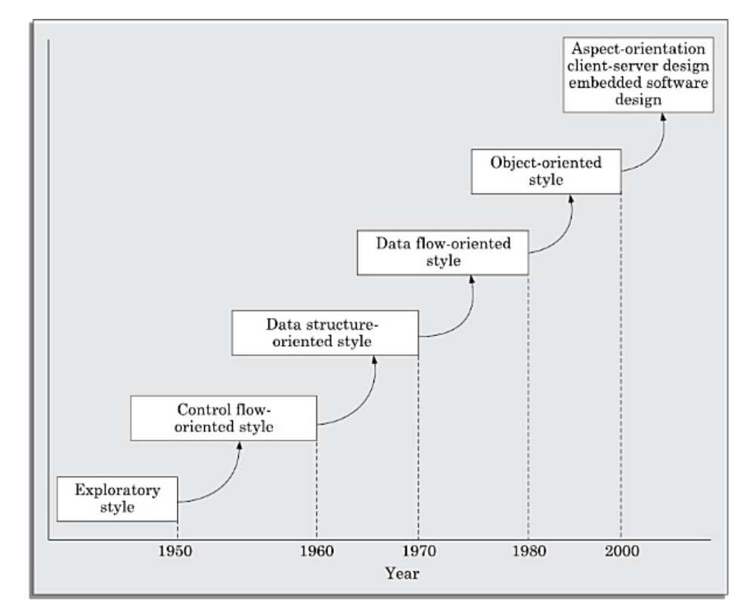
Emergence of software engineering

Slide 18
Notable changes in software development practices
To examine the glaring differences between exploratory style of software development and another development effort based on modern software engineering practices are:
1. An important difference is that the exploratory software development style is based on error correction (build and fix) while the software engineering techniques are based on the principles of error prevention.

Slide 19
Notable changes in software development practices
2. A lot of attention is now being paid to requirements specification. Significant effort is being devoted to develop a clear and correct specification of the problem before any development activity starts. Unless the requirements specification is able to correctly capture the exact customer requirements, large number of rework would be necessary at a later stage. Such rework would result in higher cost of development and customer dissatisfaction.

Slide 20
Notable changes in software development practices
3. Periodic reviews are being carried out during all stages of the development process. The main objective of carrying out reviews is phase containment of errors, i.e. detect and correct errors as soon as possible.
4. software testing has become very systematic and standard testing techniques are available. Testing activity has also become all encompassing, as test cases are being developed right from the requirements specification stage.

Slide 21
Notable changes in software development practices
5. project planning is to ensure that the various development activities take place at the correct time and no activity is halted due to the want of some resource. Project planning normally includes preparation of various types of estimates, resource scheduling, and development of project tracking plans.

Slide 22
COMPUTER SYSTEMS ENGINEERING
Any software being developed would run on some general-purpose hardware platform such as a desktop computer or a server.
But, in several situations it may be necessary to develop special hardware on which the software would run. ( Like Robots)
Computer systems engineering addresses development of such systems requiring development of both software and specific hardware to run the software.

Slide 23
COMPUTER SYSTEMS ENGINEERING
The functionality implemented in hardware run faster. On the other hand, functionalities implemented in software is easier to extend. Further, it is difficult to implement complex functions in hardware. Also, functions implemented in hardware incur extra space, weight, manufacturing cost, and power overhead.

Slide 24
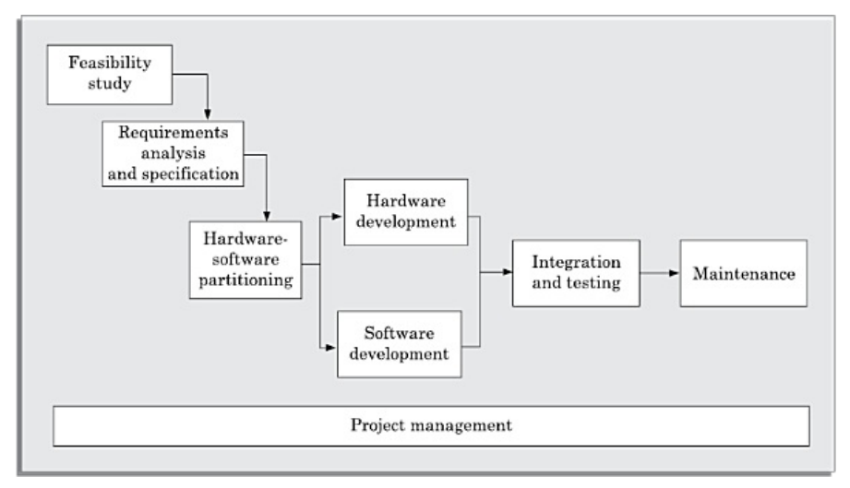
COMPUTER SYSTEMS ENGINEERING
Fig: Computer systems engineering

Slide 25
SOFTWARE LIFE CYCLE MODELS
To imply the different stages (or phases) over which a software evolves from an initial customer request for it, to a fully developed software, and finally to a stage where it is no longer useful to any user, and then it is discarded.

Slide 26
Software development life cycle (SDLC) model
A software development life cycle (SDLC) model (also called software life cycle model and software development process model ) describes the different activities that need to be carried out for the software to evolve in its life cycle.

Slide 27
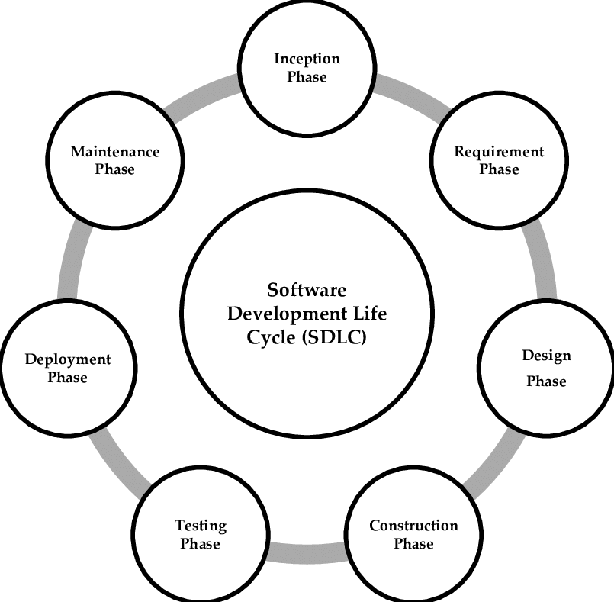

Slide 28
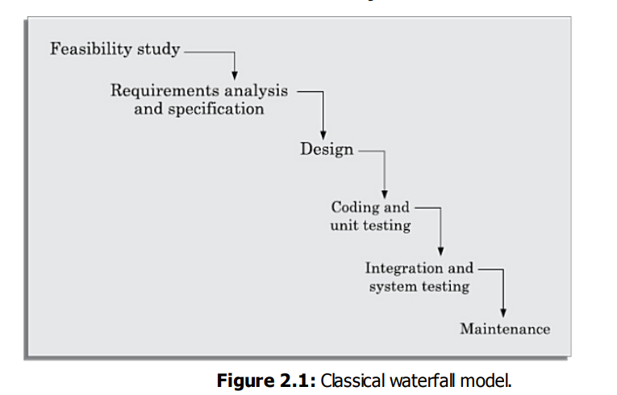
WATERFALL MODEL AND ITS EXTENSIONS
Classical Waterfall Model
Classical waterfall model is intuitively the most obvious way to develop software. It is simple but idealistic.

Slide 29
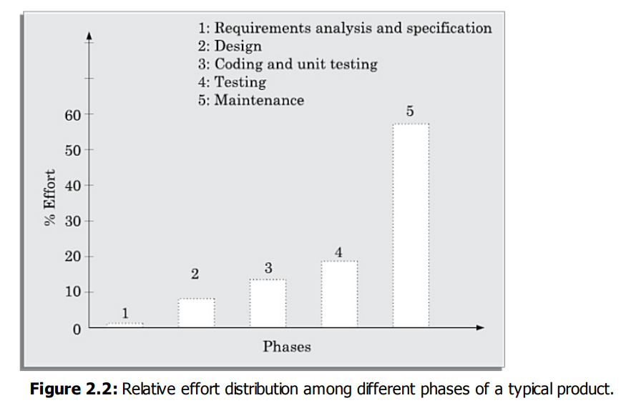
Phases of the classical waterfall model

Slide 30
Phases of the classical waterfall model
1.Feasibility study
The main focus of the feasibility study stage is to determine whether it would be financially and technically feasible to develop the software.
Feasibility study involves carrying out several activities such as collection of basic information relating to the software
Development of an overall understanding of the problem
Formulation of the various possible strategies for solving the problem
Evaluation of the different solution strategies

Slide 31
Phases of the classical waterfall model
2. Requirements gathering and analysis: The goal of the requirements' gathering activity is to collect all relevant information regarding the software to be developed from the customer with a view to clearly understand the requirements.
Requirements specification: After the requirement gathering and analysis activities are complete, the identified requirements are documented. This is called a software requirements specification (SRS) document.

Slide 32
Phases of the classical waterfall model
3. Design
In technical terms, during the design phase the software architecture is derived from the SRS document.
procedural and object-oriented design approaches are used

Slide 33
Phases of the classical waterfall model
4. Coding and unit testing
The purpose of the coding and unit testing phase is to translate a
software design into source code and to ensure that individually each function is working correctly.
The coding phase is also sometimes called the implementation phase, since the design is implemented into a
workable solution in this phase.

Slide 34
Phases of the classical waterfall model
5. Integration and system testing
During the integration and system testing phase, the different modules are integrated in a planned manner.
Finally, after all the modules have been successfully integrated and tested, the full working system is obtained.
System testing is carried out on this fully working system.
Acceptance testing: After the software has been delivered, the customer performs system testing to determine whether to accept the delivered software or to reject it.

Slide 35
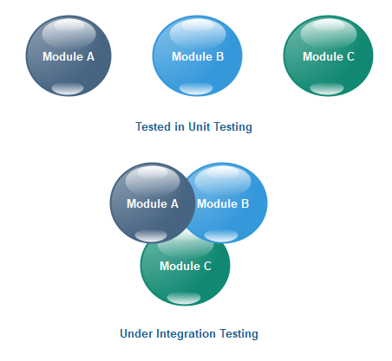
Phases of the classical waterfall model

Slide 36
Phases of the classical waterfall model
6. Maintenance
The ratio of relative effort of developing a typical software product and the total effort spent on its maintenance is roughly 40:60

Slide 37
Shortcomings of the classical waterfall model
No feedback paths
Difficult to accommodate change requests
Inefficient error corrections
No overlapping of phases

Slide 38
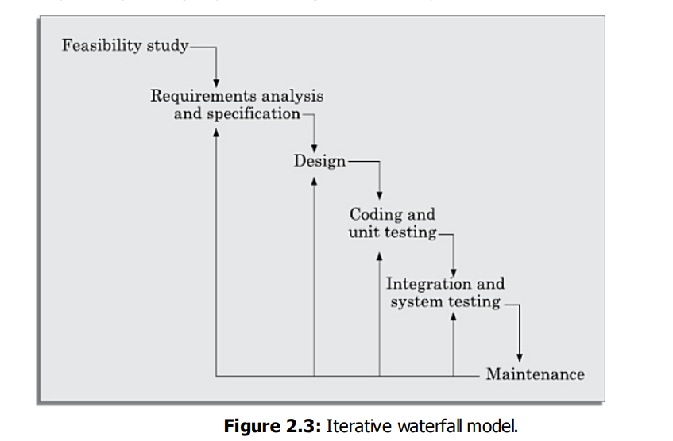
Iterative Waterfall Model
The main change brought about by the iterative waterfall model to the classical waterfall model is in the form of providing feedback paths from every phase to its preceding phases

Slide 39
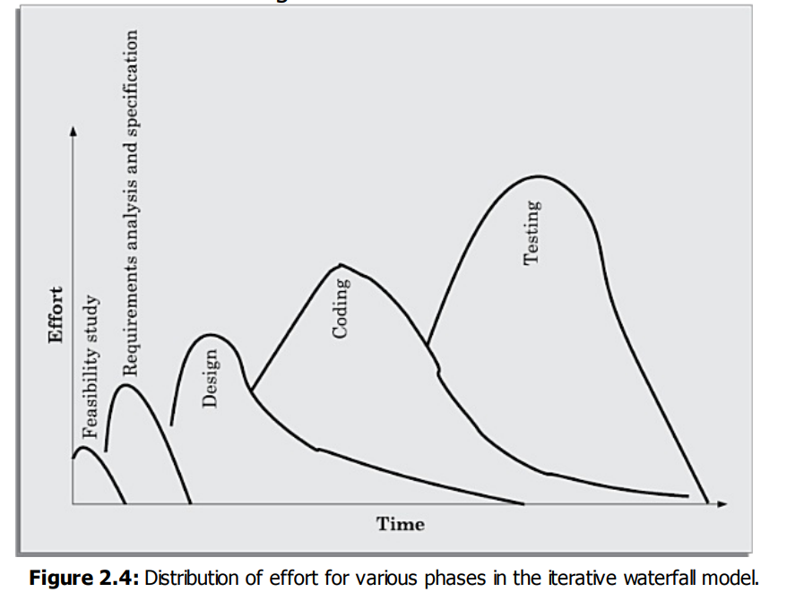
Iterative Waterfall Model

Slide 40
Comparison of model phases

Slide 41
Comparison of effort distribution

Slide 42
V-Model
V-model is a variant of the waterfall model.
In this model verification and validation activities are carried out throughout the development life cycle, and therefore the chances bugs in the work products considerably reduce.
This model is therefore generally considered to be suitable for use in projects concerned with development of safety-critical software that are required to have high reliability

Slide 43
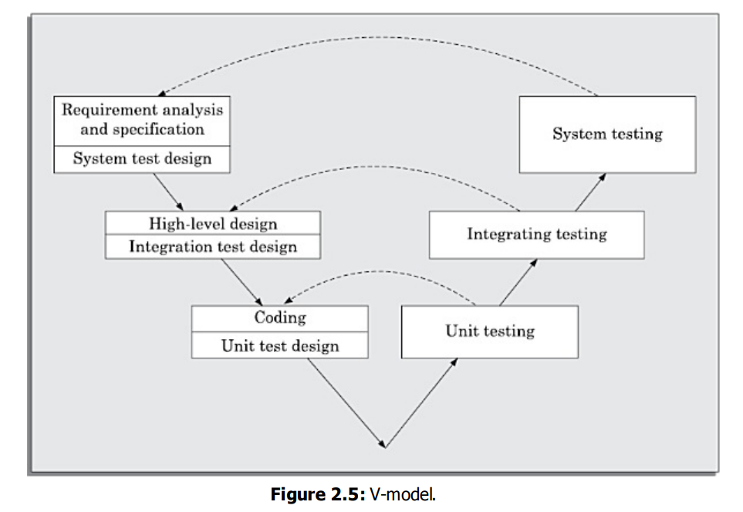
V-Model

Slide 44
Prototyping Model
The prototyping model can be considered to be an extension of the waterfall model.
This model suggests building a working prototype of the system, before development of the actual software.
A prototype is a toy and crude implementation of a system. It has limited functional capabilities, low reliability, or inefficient performance as compared to the actual software.

Slide 45
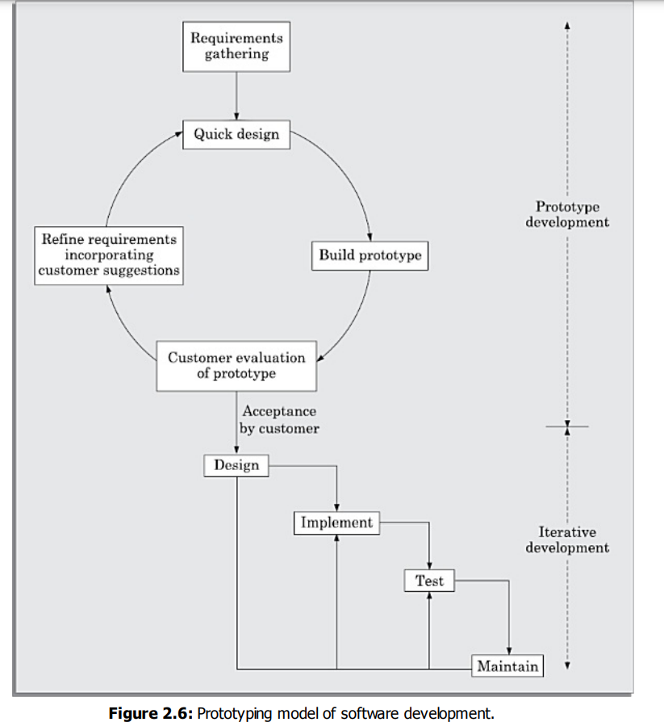
Prototyping Model

Slide 46
Incremental Development Model
In this life cycle model, first a simple working system implementing only a few basic features is built and delivered to the customer.
Over many successive iterations successive versions are implemented and delivered to the customer until the desired system is realized

Slide 47
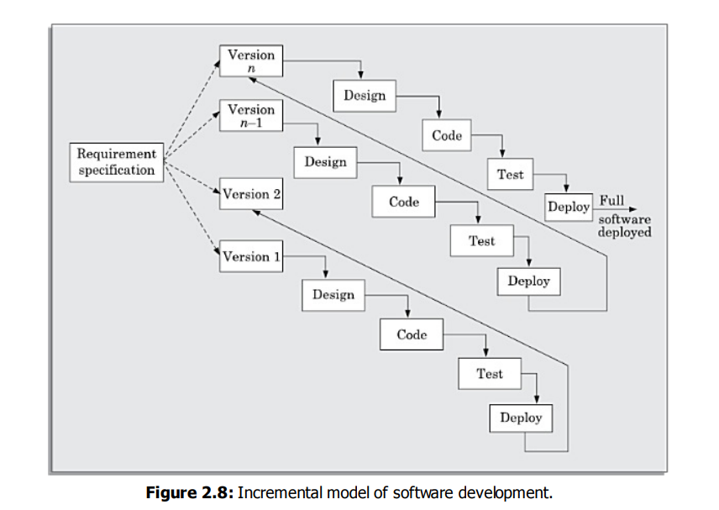
Incremental Development Model

Slide 48
RAPID APPLICATION DEVELOPMENT (RAD)
The rapid application development (RAD) model was proposed in the early nineties in an attempt to overcome the rigidity of the waterfall model (and its derivatives) that makes it difficult to accommodate any change requests from the customer.
This model has the features of both prototyping and evolutionary models.

Slide 49
RAPID APPLICATION DEVELOPMENT (RAD)
In this model prototypes are constructed, and incrementally the features are developed and delivered to the customer.
But unlike the prototyping model, the prototypes are not thrown away but are enhanced and used in the software construction

Slide 50
RAPID APPLICATION DEVELOPMENT (RAD)
The major goals of the RAD model are as follows:
To decrease the time taken and the cost incurred to develop software systems.
To limit the costs of accommodating change requests.
To reduce the communication gap between the customer and the developers.

Slide 51
AGILE DEVELOPMENT MODELS
A few reasons why the waterfall-based development was becoming difficult to use in project in recent times:
In the traditional iterative waterfall-based software development models, the requirements for the system are determined at the start of a development project and later changes are not supported
Waterfall model is called a heavy weight model, since there is too much emphasis on producing documentation and usage of tools. This is often a source of inefficiency and causes the project completion time to be late.
iterative waterfall model is not suitable for development of such customized software.

Slide 52
AGILE DEVELOPMENT MODELS
A few popular agile SDLC models are the following:
Crystal
Atern (formerly DSDM)
Feature-driven development S
Scrum
Extreme programming (XP)
Lean development
Unified process

Slide 53
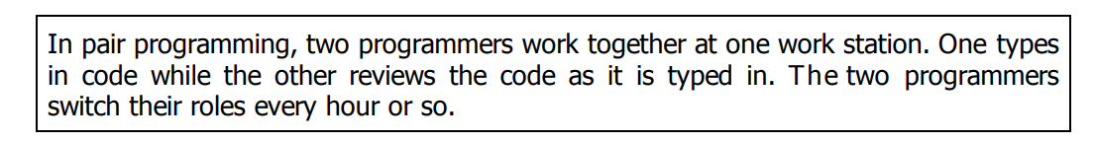
AGILE DEVELOPMENT MODELS
Agile development projects usually deploy pair programming.

Slide 54
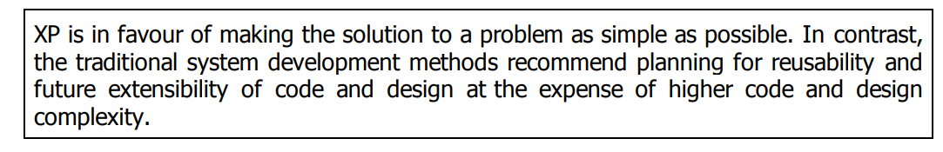
AGILE DEVELOPMENT MODELS - Extreme Programming Model
Extreme programming (XP) is an important process model under the agile umbrella and was proposed by Kent Beck in 1999.
Design: Simplicity
Code review: Pair Programming
Testing: Test-Driven Development (TDD)

Slide 55
AGILE DEVELOPMENT MODELS - Scrum Model
In the scrum model, a project is divided into small parts of work that can be incrementally developed and delivered over time boxes that are called sprints.
Each sprint typically takes only a couple of weeks to complete.
At the end of each sprint, stakeholders and team members meet to assess the progress made and the stakeholders suggest to the development team any changes needed to features that have already been developed and any overall improvements that they might feel necessary.
In the scrum model, the team members assume three fundamental roles— software owner, scrum master, and team member.

Slide 56
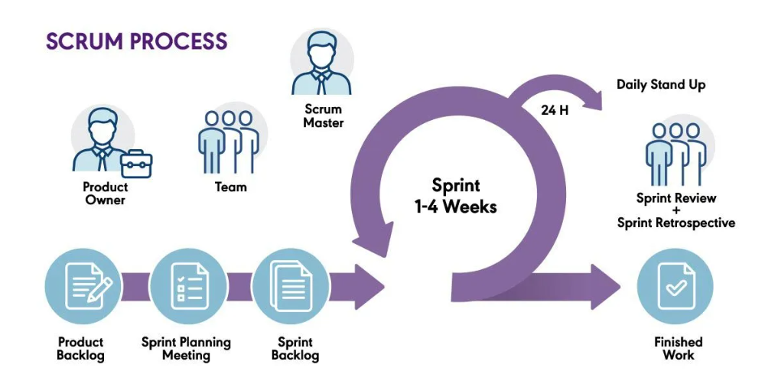
AGILE DEVELOPMENT MODELS - Scrum Model

Slide 57
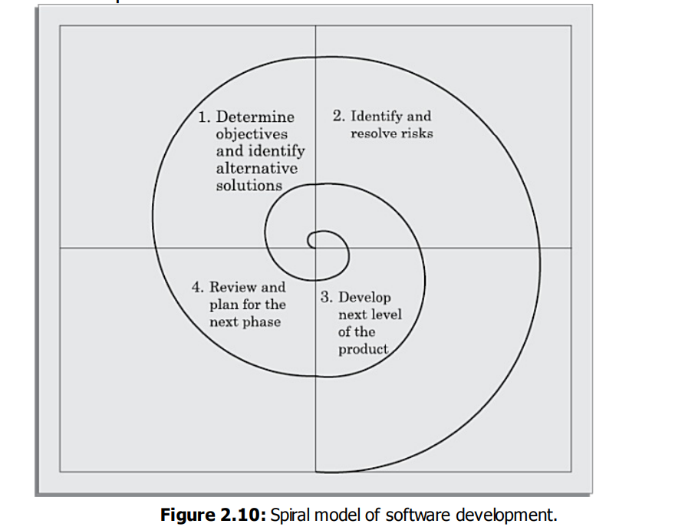
SPIRAL MODEL

Slide 58
SPIRAL MODEL
Quadrant 1: The objectives are investigated, elaborated, and analysed. Based on this, the risks involved in meeting the phase objectives are identified. In this quadrant, alternative solutions possible for the phase under consideration are proposed.
Quadrant 2: During the second quadrant, the alternative solutions are evaluated to select the best possible solution. To be able to do this, the solutions are evaluated by developing an appropriate prototype.
Quadrant 3: Activities during the third quadrant consist of developing and verifying the next level of the software. At the end of the third quadrant, the identified features have been implemented and the next version of the software is available.
Quadrant 4: Activities during the fourth quadrant concern reviewing the results of the stages traversed so far (i.e. the developed version of the software) with the customer and planning the next iteration of the spiral.

Slide 59
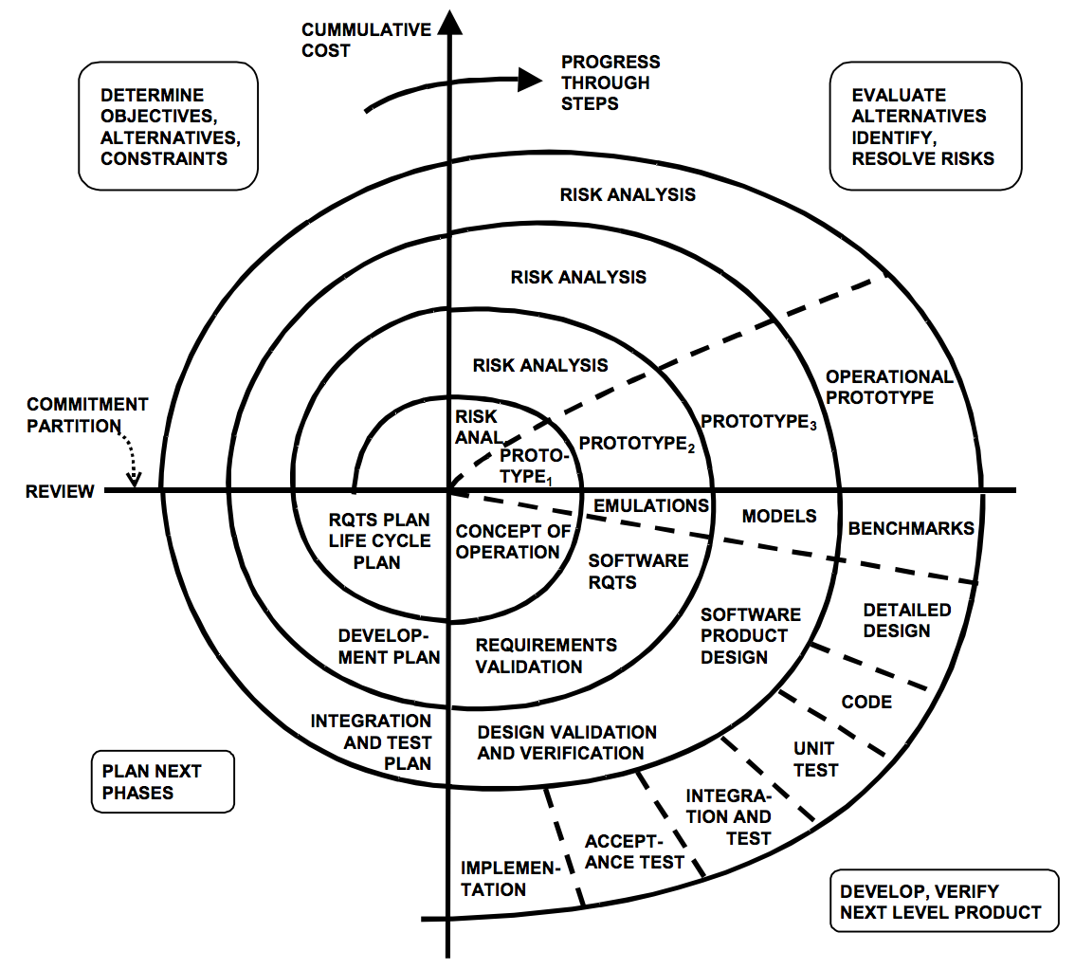
SPIRAL MODEL

